Slide 1

17
CUSTOMIZABLE templates FOR CREATING SHAREABLE GRAPHICS ON
social media.

Slide 2
Why use these templates?
Many marketers understand the need for social media. But once you’re using this channel, are you using it to the best of its ability?
Data from Performics shows that People are most likely to engage with branded content on social media that contains pictures (44%), followed by status updates (40%) and videos (37%).
But just because visual content performs best doesn’t mean we all have the skills or resources to create it every day. That’s why we built these simple, but effective, templates for you to customize and use in your social media marketing.
You’ll find three types of templates: title slides, headline roundups, and “snackable” graphics. Each will be further explained throughout this PowerPoint, along with tips for stylizing each. Enjoy!

Slide 3
Why use these templates?
EXECUTE BETTER
MOVE FASTER
CREATE MARKETING PEOPLE LOVE
Create better visuals for your social media marketing.
Don’t start from scratch or reinvent. Just plug and promote!
Create content that others actually enjoy, share, and crave.

Slide 4

“Title Slides” for Increased Exposure
The #1 Inbound Marketing Platform | HubSpot.com | @HubSpot

Slide 5
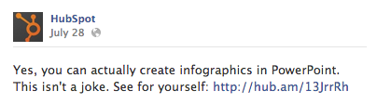
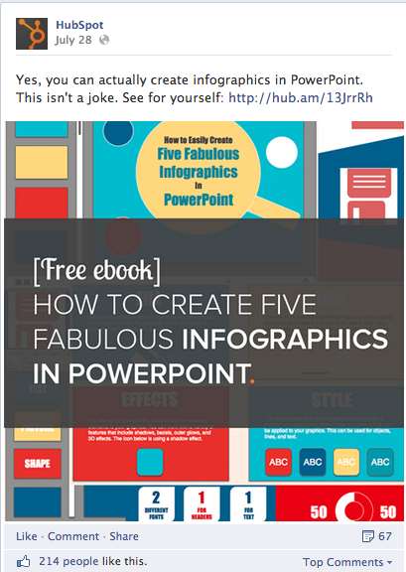
How to Create This “Title Slide” Visual
TURN THIS:
INTO THIS:
This template will help you take a simple status update – such as a blog post, article, or marketing offer – and turn it into a visual representation of that the social media user could be reading, using, or enjoying.

Slide 6

OPTION 1
How to Use This Template:
Write your own title.
Right click the image and select “Save as Picture.”
Post the image file to social.
TIP: If you plan to post to Facebook, include a text caption and link to your content too!
Title of Content You’re Sharing Goes Here
All the photos used in this template are photos that can be used in a public domain.

Slide 7
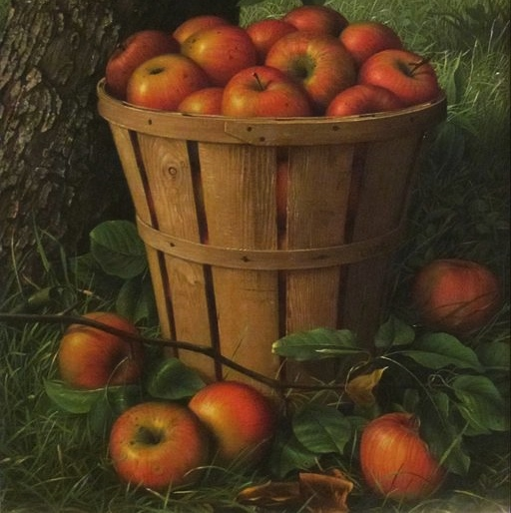
OPTION 2
Title of Content You’re Sharing Goes Here

Slide 8

OPTION 3
Title of Content You’re Sharing Goes Here
Try adjusting the font to stylize the image further. For example, you could bold the statement you want to leave an imprint.

Slide 9

OPTION 4
Be open to adjusting the template layout to accommodate various images or messages.
Title of Content You’re Sharing Goes Here

Slide 10

OPTION 5
Title of Content You’re Sharing Goes Here

Slide 11

OPTION 6
Title of Content You’re Sharing Goes Here

Slide 12

OPTION 7
Title of Content You’re Sharing Goes Here

Slide 13

OPTION 8
To receive 75 additional free stock photos you can use in your social media visuals, head here: http://bitly.com/75StockSocial
Title of Content You’re Sharing Goes Here

Slide 14

OPTION 9
Title of Content You’re Sharing Goes Here

Slide 15

OPTION 10
Title of Content You’re Sharing Goes Here

Slide 16

OPTION 11
Title of Content You’re Sharing Goes Here

Slide 17
BLANK VERSION
Instructions Specific
to This Template:
Add an image you own or have purchased as the square background.
Right click the added image image, go to arrange, and select “send to back” in the dropdown.
Write your own title.
Select the gray box and background image, then right click > grouping > group.
Right click on the whole image and select save as picture.
Post to social media!
Title of Content You’re Sharing Goes Here

Slide 18
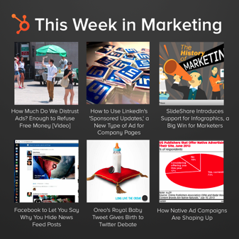
“Headline Roundups” for Industry News
The #1 Inbound Marketing Platform | HubSpot.com | @HubSpot

Slide 19
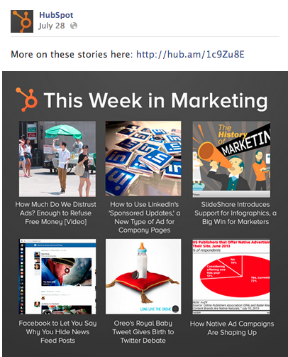

Why create a “Headline Roundups” visual?
ADDING VALUE LIKE THIS:
CAN HELP DRIVE THIS:
A roundup of stories can help you consolidate multiple content pieces into one image while creating a shareable photo for social.

Slide 20

How to Use This Template:
Double click on any image in the template to replace it with your own.
Double click on any text box to customize it with text that matches the chosen image.
Once each story is completed, right click on the entire grouped image and select “save as picture.”
Benefit: When a follower shares your image with friends, your text comment, content link, and profile link are shared with it. That’s extra reach and calls-to-action spreading around Facebook – all thanks to your sweet image!
Your Headline Here
Your story headline goes here. Make it short and sweet!
Your story headline goes here. Make it short and sweet!
Your story headline goes here. Make it short and sweet!
Your story headline goes here. Make it short and sweet!
Your story headline goes here. Make it short and sweet!
Your story headline goes here. Make it short and sweet!

Slide 21
OPTION 1
Your Headline Here
Your story headline goes here. Make it short and sweet!
Your story headline goes here. Make it short and sweet!
Your story headline goes here. Make it short and sweet!
Your story headline goes here. Make it short and sweet!
Your story headline goes here. Make it short and sweet!
Your story headline goes here. Make it short and sweet!

Slide 22

OPTION 2
Your Headline Here
Your story headline goes here. Make it short and sweet!
Your story headline goes here. Make it short and sweet!
Your story headline goes here. Make it short and sweet!
Your story headline goes here. Make it short and sweet!

Slide 23

OPTION 3
Your Headline Here
Feel free to delete images from the template to add or remove stories. Don’t force six stories to meet the original template, do what works for your social sharing.
Your story headline goes here. Make it short and sweet!

Slide 24
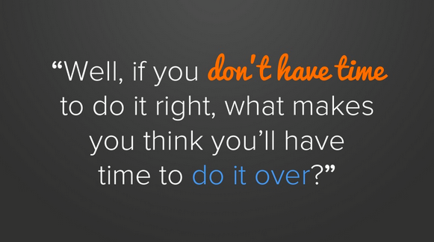
“Snackable Graphics” for Quotes & Stats
The #1 Inbound Marketing Platform | HubSpot.com | @HubSpot

Slide 25
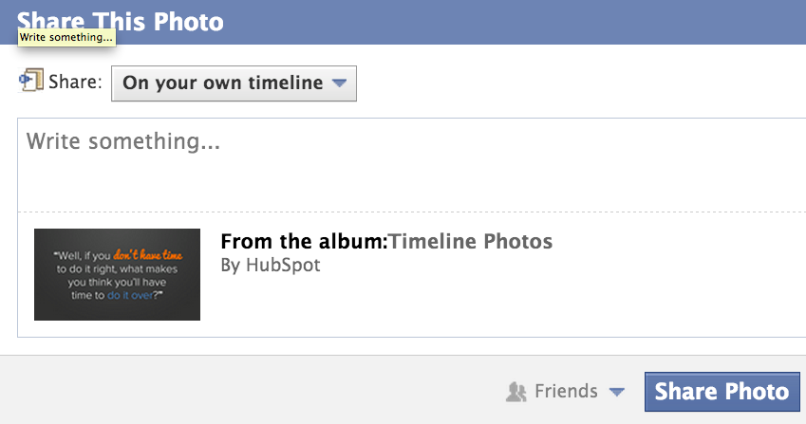
Why create a “Snackable Graphics” visual?
CREATING IMAGES LIKE THIS:
CAN HELP DRIVE THIS:
Rather than simply updating your social platform with a text update, create an image that showcases that stat or quote in an interesting display.

Slide 26
OPTION 1
How to Use This Template:
Click on the quote or stat to adjust for your own sharing needs.
Click on the “Source” text box to properly cite the quote or stat.
Right click on the entire image to “Save as Picture.”
Share on social media!
TIP: If you plan to share the visual on Twitter, include the Twitter handle for the data source or person who said the quote – maybe the brand or person will retweet it!
70% of Fortune 500 CEOs Aren't Using Social Media.”
Source: Mashable

Slide 27
OPTION 2
Whenever you find yourself on the side of the majority, it is time to pause and reflect.”
Mark Twain
Change font colors or bold parts of a quote to make it stand out.

Slide 28
OPTION 3
Though we may come from different countries and speak in different tongues, our hearts beat as one.
Adjust the font type for specific words to call them out within an image.
Albus Dumbledore

Slide 29
How to Use Your Finalized Images
Once you begin finalizing images from this template set, don’t just create and publish instantly.
While our goal is make your job easier with these templates, repetition of the same format or style can get stale. Mix up which templates you use each week! In addition, test using normal text-based updates with these images to see how the visual updates perform in comparison to the text updates.
Best of luck!

Slide 30
RATE THIS CONTENT & HELP HUBSPOT IMPROVE.
HubSpot believes in creating content for you (not for us), so we’d like to hear what you thought of these templates! Submit a 1-10 rating in a matter of seconds by clicking here. Your feedback goes directly to our content team.
SUBMIT RATING:
http://bitly.com/17SocialTemplatesNPS

